Slide 1


Self-Supervised Transformer Imputation for Reliable Prognostics Under Missing Data
Austin Coursey and Abel Diaz-Gonzalez

Slide 2
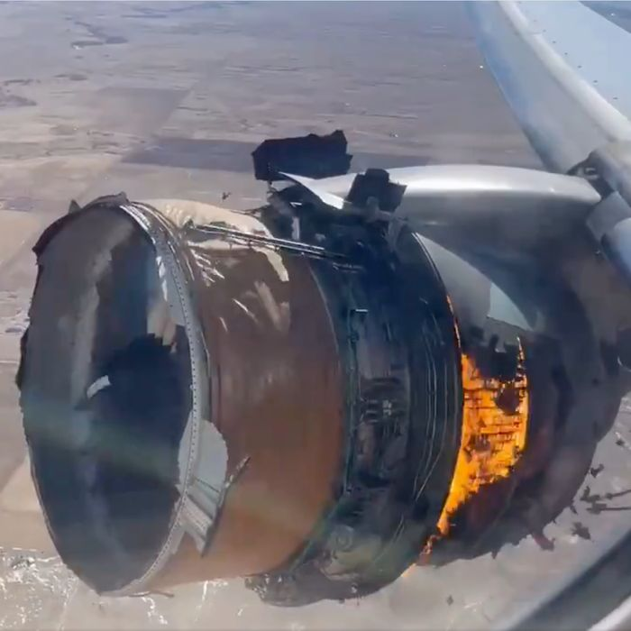
Problem Motivation
Being able to determine the remaining useful life (RUL) of a system or component is important
Safety, maintenance, reliability
Many data-driven solutions to RUL estimation assume no missing data
Is this realistic? What if something goes wrong?
We need to be robust to missing data
Airplane engine failure. Credit: https://nymag.com/intelligencer/2021/02/watch-terrifying-video-of-united-328-in-flight-engine-fire.html

Slide 3
Existing Solutions
Classic approaches
Linear interpolation, SVMs, backfill, etc.
Recent approaches
Largely GANs [1,2,3], Gaussian Process Regression [4]
Most do not consider temporality
Multivariate time series data
What about transformers?
Have been used for time series imputation [5]
Reconstructing masks has also been used for self-supervised learning [6,7,8]

Slide 4







Method
Rationale
Pretext Task (Pretraining Loop)
Transformer can impute missing data [5]
Learning to impute missing data may lead to useful representations for RUL predictions
Transformer
Sensor data with deleted values
Encoder Block
Recons. Head
Reconstructed sensor data
E
z
R
X’
$$\hat{X}$$
$$L(X,\hat{X})$$
Encoder Block
RUL Head
E
$$z+\hat{X}$$
RUL
$$RUL_{t}$$
…
$$\hat{X}$$
Reconstructed sensor data
RUL Prediction

Slide 5
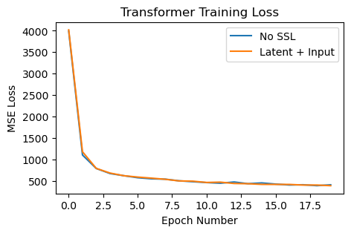
Results
Trained models 10 times on aircraft engine failure (simulated) dataset
Finding:
SSL only slightly helped
Transformer imputation only slightly better than linear interpolation
Why?
Dataset small (80 train flights, 20 test, ~20,000 train samples)
Masking algorithm too easy
Linear interpolation may be good enough here
Model | Mean RMSE(SD)
No SSL’ | 13.71(2.32)
Only Latent*’ | 56.34(1.43)
Latent + Input*’ | 12.99(0.76)
Linear Interpolation | 14.00(1.39)
*uses SSL
‘uses Transformer Imputation

Slide 6
Sources
[1] Hyunsoo Lee, Seok-Youn Han, and Kee-Jun Park. Generative adversarial network-based missing data handling and remaining useful life estimation for smart train control and monitoring systems. Journal of Advanced Transportation, 2020:1–15, Nov 2020
[2] Chen Wenbai, Liu Chang, Chen Weizhao, Liu Huixiang, Chen Qili, and Wu Peiliang. A prediction method for the rul of equipment for missing data. Complexity, 2021:1–10, Dec 2021.
[3] Yu Huang, Yufei Tang, James VanZwieten, and Jianxun Liu. Reliable machine prognostic health management in the presence of missing data. Concurrency and Computation: Practice and Experience, 34(12), May 2020.
[4] Pham Luu Trung Duong and Nagarajan Raghavan. Prognostic health management for led with missing data: Multi-task gaussian process regression approach. In 2018 Prognostics and System Health Management Conference (PHM-Chongqing), page 1182–1187, Chongqing, 2018. IEEE.
[5] A. Yarkın Yıldız, Emirhan Koc, and Aykut Koc. Multivariate time series imputation with transformers. IEEE Signal Processing Letters, 29:2517–2521, 2022.
[6] Yiwei Fu and Feng Xue. Mad: Self-supervised masked anomaly detection task for multivariate time series. In 2022 International Joint Conference on Neural Networks (IJCNN), page 1–8, Padua, Italy, Jul 2022. IEEE.
[7] Wenrui Zhang, Ling Yang, Shijia Geng, and Shenda Hong. Cross reconstruction transformer for self-supervised time series representation learning. May 2022. arXiv:2205.09928 [cs].
[8] Zhe Li, Zhongwen Rao, Lujia Pan, Pengyun Wang, and Zenglin Xu. Ti-mae: Self-supervised masked time series autoencoders. Jan 2023. arXiv:2301.08871 [cs].

